Slide 1
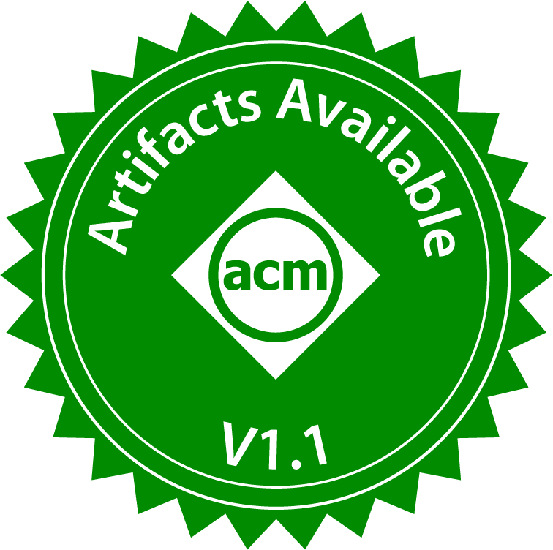


NearPM: A Near-memory Processing System for Storage-class Applications
Yasas Seneviratne, Korakit Seemakhupt, Sihang Liu, and Samira Khan
https://github.com/Systems-ShiftLab/NearPMHW https://github.com/Systems-ShiftLab/NearPMSW
Notes:
Hello everyone I’m Yasas Seneviratne, today I will be presenting our work NearPM: A Near-memory Processing System for Storage-class Applications which I did with my collaborators at the University of Virginia

Slide 2
Summary
Storage-class applications need crash consistency
To enable failure-recovery, these applications need to
Perform memory operations in specific orders
Introduce additional data-intensive operations (e.g., logging)
Data-intensive operations are well suited for near data processing (NDP)
Our proposal NearPM:
Accelerates common operations in crash consistency mechanisms
Enforces memory operation ordering near memory
Further scales multiple NearPM devices
We prototyped and evaluated NearPM on an FPGA system
1.22x - 1.35x faster than conventional CPU systems

Slide 3
Outline
Background and Motivation
Challenges and Key Ideas
Implementation of NearPM
Evaluation
Notes:
First I will talk about the motivation of our work

Slide 4

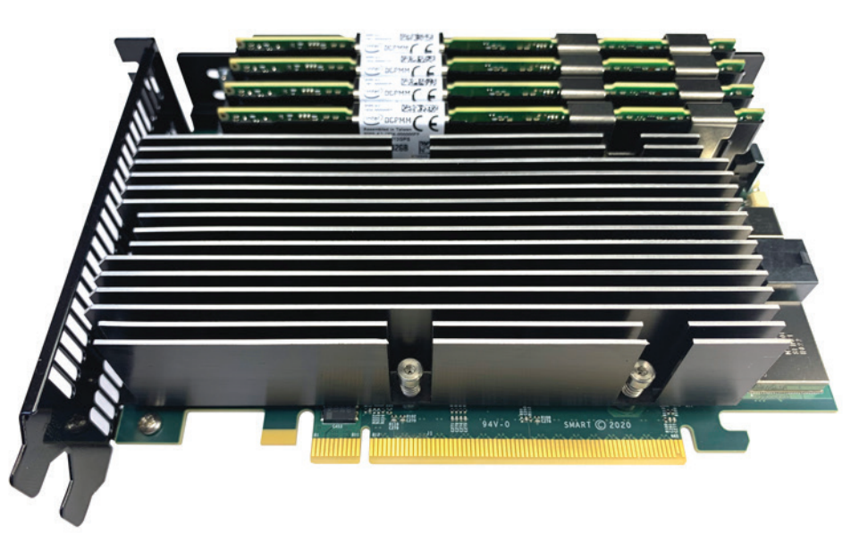

Persistent Memory
DCPMM
Persistent memory (PM) features:
High-performance
Byte-addressability
Data-persistence
Existing PMs are installed on memory bus
Future PM are expected to be CXL-based
PM allows programs to bypass operating system indirections
Memory management is delegated from file system to user-space
Programs use PM to ensure the crash consistency of persistent data, i.e., Program can recover to a consistent state after failure
CXL memory module
Notes:
By storing program state in persistent memory programs can recover to a consistent state after a failure
Talk abt cxl

Slide 5
Background
Crash consistent programs recover program state even after failure
This requires additional tracking of data and added operations

Slide 6
Background
Crash consistent programs recover program state even after failure
This requires additional tracking of data and added operations
1 generate_metadata();
2 copy_origin_to_ulog();
3 update();
4 delete_log();
New value
Undo log
Old value
Notes:
add code example

Slide 7
Background
Crash consistent programs recover program state even after failure
This requires additional tracking of data and added operations
1 generate_metadata();
2 copy_origin_to_ulog();
3 update();
4 delete_log();
New value
Undo log
Metadata
Old value
object ID, commit status, log offset etc.

Slide 8
Background
Crash consistent programs recover program state even after failure
This requires additional tracking of data and added operations
1 generate_metadata();
2 copy_origin_to_ulog();
3 update();
4 delete_log();
New value
Undo log
Metadata
Old value
Old value copy

Slide 9
Background
Crash consistent programs recover program state even after failure
This requires additional tracking of data and added operations
1 generate_metadata();
2 copy_origin_to_ulog();
3 update();
4 delete_log();
New value
Undo log
Metadata
Old value
Old value copy

Slide 10
Background
Crash consistent programs recover program state even after failure
This requires additional tracking of data and added operations
1 generate_metadata();
2 copy_origin_to_ulog();
3 update();
4 delete_log();
Undo log
Metadata
New value
Old value copy
How critical is this added overhead?

Slide 11
Motivation
Crash consistency overhead can take around 48% of the execution time
33% of the execution time is data movement within persistent memory
Logging crash consistency overhead
Average crash consistency overhead
How can we mitigate these memory-intensive operations?
Notes:
redraw graph
font
1 slide : all workloads (revert the order)
2. slide: summery with better graph

Slide 12
Motivation
Crash consistency mechanisms need back-and-forth data movement between CPU and PM
Near data processing (NDP) reduces data movement
NDP accelerates memory-intensive operations with simple logic
CPU
Old data
CPU
NDP
Old data
Log
Log
PM
PM
Costly data movement
Cheap data movement
How can NDP accelerate different crash consistency mechanisms?
Notes:
The operations are data intensive and NDP can be a good solution
Use fig 3 from paper
NDP use simple processing near memory to do data intensive ops
“How can different crash consistency be supported”

Slide 13
Observation
Crash consistency operations can be divided into common sub operations
Undo log
Generate metadata
Copy to undolog
Update value
Delete log
Redo log
Generate metadata
Write to redolog
Copy to value
Delete log
Checkpoint
Generate metadata
Copy to checkpoint
Copy to value
Shadow paging
Copy values to shadow page
Change reference
Notes:
We analyzed the workloads and realized that common operations can be extracted from different crash consistency mechanisms

Slide 14
Observation
Crash consistency operations can be divided into common sub operations
These common operations are simple and data-intensive
Undo log
Generate metadata
Copy to undolog
Update value
Delete log
Redo log
Generate metadata
Write to redolog
Copy to value
Delete log
Checkpoint
Generate metadata
Copy to checkpoint
Copy to value
Shadow paging
Copy values to shadow page
Change reference
These common crash consistency operations
are well suited for NDP
Notes:
Crash consistency mechanisms can be divided into common sub operations,
Several of these operation are very well suited for near data processing.”
“Different operations in different colors”
remove start

Slide 15
Outline
Background and Motivation
Challenges and Key Ideas
Implementation of NearPM
Evaluation

Slide 16
Challenges and Key ideas
CPU-NDP ordering
NDP-NDP ordering
NDP
CPU
NDP
PM
PM

Slide 17
Challenges and Key ideas
CPU-NDP ordering
NDP-NDP ordering
NDP
CPU
NDP
PM
PM

Slide 18
Ordering in crash consistent programs
NDP and CPU can execute operations in parallel
Naively letting them execute can result in unrecoverable states
Crash consistent programs need to guarantee ordering
Undo log of memory location x
Offload
Log
Offload
commit
CPU
Update value
NDP
Generate metadata
Copy to undolog
Commit
Delete log
PM
Read x
NDP backs up data that is already updated
Write x
Notes:
For best performance from NDP we need to make sure CPU and execute in parallel
Naively executing them can result in ordering violations
Lets look at an example of undolog generation using near data processing
Go step by step in animation

Slide 19
Ordering in crash consistent programs
NDP and CPU can execute operations in parallel
Naively letting them execute can result in unrecoverable states
Crash consistent programs need to guarantee ordering
Undo log of memory location x
Offload
Log
Offload
commit
Offload
recovery
CPU
Update value
NDP
Generate metadata
Copy to undolog
Commit
Delete log
Recovery
PM
Read x
Read from already updated data
Write x
Ordering must be guaranteed between CPU and NDP
Notes:
For best performance from NDP we need to make sure CPU and execute in parallel
Naively executing them can result in ordering violations
Lets look at an example of undolog generation using near data processing
Go step by step in animation

Slide 20
Naïve solution: CPU-centric ordering
Naïve CPU based ordering result in significant communication overhead
The NDP performance gain is foreshadowed by communication overhead
Undo log of memory location x
Offload
Log
Offload
commit
Offload
recovery
CPU
Update value
CPU NDP ordering
NDP
Generate metadata
Copy to undolog
Commit
Delete log
Recovery
PM
Read x
write log
Write x
Read from consistent data
Notes:
For best performance from NDP we need to make sure CPU and execute in parallel
Naively executing them can result in ordering violations
Lets look at an example of undolog generation using near data processing
Go step by step in animation

Slide 21
PPO: CPU-NDP Partitioned persist ordering
NearPM handles ordering near memory
NearPM removes the communication overhead of the naïve solution
Memory operations are committed to PM in program order by NearPM
We call this CPU-NDP partitioned persist ordering (PPO)
CPU-NDP PPO also provides an added benefit
Undo log of memory location x
Offload
Log
Offload
commit
Offload
recovery
CPU
Update value
NDP
Generate metadata
Copy to undolog
Commit
Delete log
Recovery
Write x
Write is stalled until read is complete
Read from consistent data
PM
Read x
Write x
Notes:
For best performance from NDP we need to make sure CPU and execute in parallel
Naively executing them can result in ordering violations
Lets look at an example of undolog generation using near data processing
Go step by step in animation

Slide 22
Additional benefit of CPU-NDP PPO
NDP can execute operations in parallel internally
Operations can execute in parallel as long as no memory is shared
Undo log of memory locations x and y
Offload
Log x
Offload
Log y
Offload
commit
Update value x
Update value y
CPU
Generate metadata x
Copy x to undolog
NDP
Commit
Delete logs
Generate metadata y
Copy y to undolog
Write x
Write y
Read x
Write x
PPO accelerates and parallelizes crash consistency operations
PM
Read y
Write y
Notes:
For best performance from NDP we need to make sure CPU and execute in parallel
Naively executing them can result in ordering violations
Lets look at an example of undolog generation using near data processing
Go step by step in animation

Slide 23
Challenges and Key ideas
CPU-NDP ordering
NDP-NDP ordering
NDP
CPU
NDP
PM
PM

Slide 24
Ordering between multiple devices
Data can be partitioned among multiple physical devices
Multi-NDP execution can result in ordering violations
Offload
Log
Offload
commit
CPU
Update value
CPU NDP ordered using PPO
NDP0
log data
Commit
Delete log
Read x
Write x
log of x
NDP1
log data
Commit
Delete log
Read x
Write x
log of x
Notes:
For best performance from NDP we need to make sure CPU and execute in parallel
Naively executing them can result in ordering violations
Lets look at an example of undolog generation using near data processing
Go step by step in animation

Slide 25
Ordering between multiple devices
Data can be partitioned among multiple physical devices
Multi-NDP execution can result in ordering violations
Recovered state could be inconsistent between devices
Offload
Log
Offload
commit
Offload
recovery
CPU
Update value
CPU NDP ordered using PPO
Keeps new update
NDP0
log data
Commit
Delete log
Recovery
Read x
Write x
NDP NDP ordering not solved
log of x
NDP1
log data
Commit
Delete log
Recovery
Recover from old data
Read x
Write x
log of x
Notes:
For best performance from NDP we need to make sure CPU and execute in parallel
Naively executing them can result in ordering violations
Lets look at an example of undolog generation using near data processing
Go step by step in animation

Slide 26
Naïve solution: CPU-centric ordering
The CPU waits for both commits to complete before deleting the logs
Naïve CPU sync can result in significant communication overhead
Offload
Log
Offload
commit
NDP NDP ordering resolved using CPU sync
Update value
Sync
CPU
CPU NDP ordered using PPO
Sync
NDP0
log data
Commit
Delete log
NDP1
log data
Commit
Delete log

Slide 27
PPO: NDP-NDP partitioned persist ordering
Naïve CPU sync can result in significant communication OH
NearPM uses inter device synchronization to overcome this OH
Inter device synchronization is well suited for technologies like CXL
Offload
Log
Offload
commit
Update value
CPU
NDP NDP ordering resolved using inter device sync
CPU NDP ordered using PPO
NDP0
log data
Commit
Delete log
Sync
NDP1
log data
Commit
Delete log
Notes:
For best performance from NDP we need to make sure CPU and execute in parallel
Naively executing them can result in ordering violations
Lets look at an example of undolog generation using near data processing
Go step by step in animation

Slide 28
Outline
Background
Motivation
Challenges and Key Ideas
Implementation of NearPM
Evaluation

Slide 29
Implementation Overview
PPO is implemented in NeaPM
CPU-NDP and NDP-NDP ordering is guaranteed by NearPM
NearPM supports several crash consistency mechanisms
Logging, Checkpointing, and Shadowpaging
CPU
NearPM
PM
Notes:
NEarPM is a implemetatoin of PPO
Draw a box around NEARPM
Supports several crash consistency mechanisms
Summerize last two bullet poits
Check paper abt implemetation

Slide 30
Implementation Overview
NearPM Architecture
NearPM unit Architecture
PPO implementation on NearPM
Ordering handling between CPU and NearPM
Ordering handling between multiple NearPM devices

Slide 31
NearPM Architecture
NearPM units
Memory mapped
command queue
NDPU 0
NDPU 1
Command dispatcher
NDPU 2
PM
Sync logic
Address monitor and
buffer logic
NDPU 3
To/From
CPU
Read write queue
Notes:
Now we look at the NearPM architecture
The cpu communicates with the NearPM device through a shared memory interface for data and commands
The commands are fed to a command queue and are then dispatched for execution in nearpm devices by a dispatcher.
To handle ordering the NearPM monitors the read write queue and makes sure that there are no ordering vioations
When executing partitioned commands the synchronization logic makes sure that the command is not retired until fellow devices complete synchronization

Slide 32
NearPM unit Architecture
To/From
PM
Metadata generator
From
Command dispatcher
Request register
Controller
Load Store unit
DMA engine

Slide 33
Implementation Overview
NearPM Architecture
NearPM unit Architecture
PPO implementation on NearPM
Ordering handling between CPU and NearPM
Ordering handling between multiple NearPM devices

Slide 34
CPU-NearPM ordering handling
Memory mapped
command queue
NearPM units
NDPU 0
2. Check for ordering conflicts
NDPU 1
NearPM access table
NearPM unit ID | Read range | Write range
0 | 0xA0 - 0xB0 | 0xC0 – 0xD0
… | … | …
Buffer enable logic
CMD dispatcher
NDPU 2
PM
Address monitor and
buffer logic
0xC0 – 0xD0
1. Monitor CPU accesses
NDPU 3
3. Buffer CPU memory operation
To/From
CPU
RD 0xC4
RD 0xC4
Read write queue
Notes:
Keep same layout similar to earlier figure
The synthesissed schematic
Change aBCD to hex numbers

Slide 35
CPU-NearPM ordering handling
Memory mapped
command queue
NearPM units
Unit 0
Unit 1
NearPM access table
NearPM unit ID | Read range | Write range
… | … | …
… | … | …
Buffer enable logic
CMD dispatcher
Unit 2
PM
Address monitor and
buffer logic
Unit 3
To/From
CPU
RD 0xC4
NearPM handles the ordering between CPU and NDP
Read write queue
4. Commit to memory when NDPU finish
Notes:
Keep same layout similar to earlier figure
The synthesissed schematic
Change aBCD to hex numbers

Slide 36
Implementation Overview
NearPM Architecture
NearPM unit Architecture
PPO implementation on NearPM
Ordering handling between CPU and NearPM
Ordering handling between multiple NearPM devices

Slide 37
Ordering handling between NearPM devices
CMD
0xB0 – 0xE0
Execution logic
CPU
Execution logic
Memory
Controller
0
Memory Controller
1
PM
PM
Sync logic
Sync logic
Device 0
Addr A-C
Device 1
Addr D-F
Notes:
Add summery overview boxes

Slide 38
Ordering handling between NearPM devices
Execution logic
CPU
Execution logic
MC0
Memory
Controller
0
MC1
Memory Controller
1
CMD
0xB0 – 0xC0
CMD
0xD0 – 0xE0
PM
PM
Sync logic
Sync logic
Device 0
Addr A-C
Device 1
Addr D-F

Slide 39
Ordering handling between NearPM devices
Execution logic
CPU
Execution logic
MC0
Memory
Controller
0
MC1
Memory Controller
1
CMD
0xB0 – 0xC0
CMD
0xD0 – 0xE0
PM
PM
Sync logic
Sync logic
Dev ID | status
Dev 0 | 0
Dev 1 | 0
Dev ID | status
Dev 0 | 0
Dev 1 | 0
Device 0
Addr A-C
Device 1
Addr D-F

Slide 40
Ordering handling between NearPM devices
Execution logic
CPU
Execution logic
MC0
Memory
Controller
0
MC1
Memory Controller
1
PM
PM
Sync logic
Sync logic
Dev ID | status
Dev 0 | 1
Dev 1 | 0
Dev ID | status
Dev 0 | 1
Dev 1 | 0
Device 0
Complete
Device 0
Addr A-C
Device 1
Addr D-F

Slide 41
Ordering handling between NearPM devices
Execution logic
CPU
Execution logic
MC0
Memory
Controller
0
MC1
Memory Controller
1
PM
PM
Sync logic
Sync logic
Dev ID | status
Dev 0 | 1
Dev 1 | 1
Dev ID | status
Dev 0 | 1
Dev 1 | 1
Device 1
Complete
NearPM handles ordering between NDP devices
Device 0
Addr A-C
Device 1
Addr D-F
Notes:
Make lighter and front larger

Slide 42
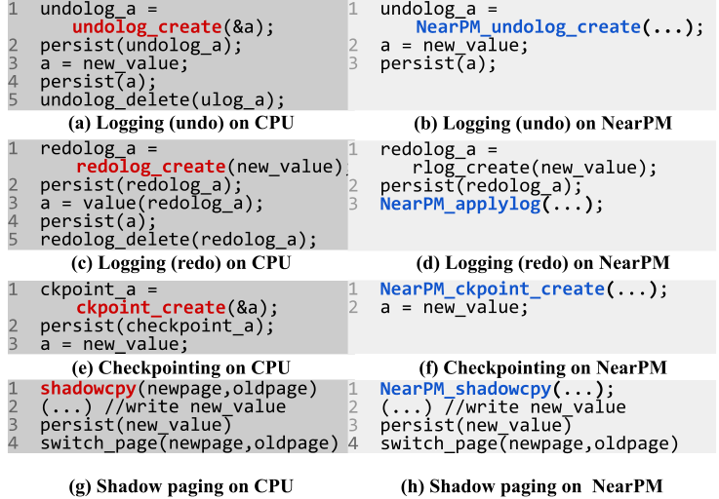
NearPM Software interface
NearPM uses separate MMIO address space for command interface
The path is memory mapped and the CPU issues required commands
The API calls can be directly used in user code
0x8000000
Command interface
0x8000FFFF
Undolog
Redolog
Device memory
0xC000000
Checkpoint
Shadowpage
A. Memory mapping
B. API examples
Notes:
The CPU uses a software interface to send commands to the NearPM device
The command interface is memory mapped to the program. The program can then use software APIs to send commands to the NearPM device

Slide 43
Outline
Background
Motivation
Challenges and Key Ideas
Implementation of NearPM
Evaluation
Notes:
Next we talk about the methodology of our work

Slide 44
Workloads
Workload | Input
TPCC, TATP | Process TPCC/TATP transactions
btree, rbtree, ctree, skiplist, hashmap | Insert random key-values (PMDK)
Redis | 100% write requests from YCSB
Memcached | 100% write requests from YCSB
pmemkv | Input from pmemkv-bench
We adapted these workloads with NearPM API
Implemented logging, checkpointing and shadow-paging for all workloads
Performance evaluation:
Speedup within crash consistency regions
Speedup of the whole program
Notes:
We use a set of workloads that is widely used for PM work evaluation

Slide 45
Evaluation
We implemented NearPM on FPGA for our evaluation
We ran the baseline on emulated persistent memory on FPGA
We emulate cacheline access over PCIe
Development Board
PCIe
FPGA
NearPM
CPU
PCIe controller
DRAM controller
Emulated PM
(DRAM)

Slide 46
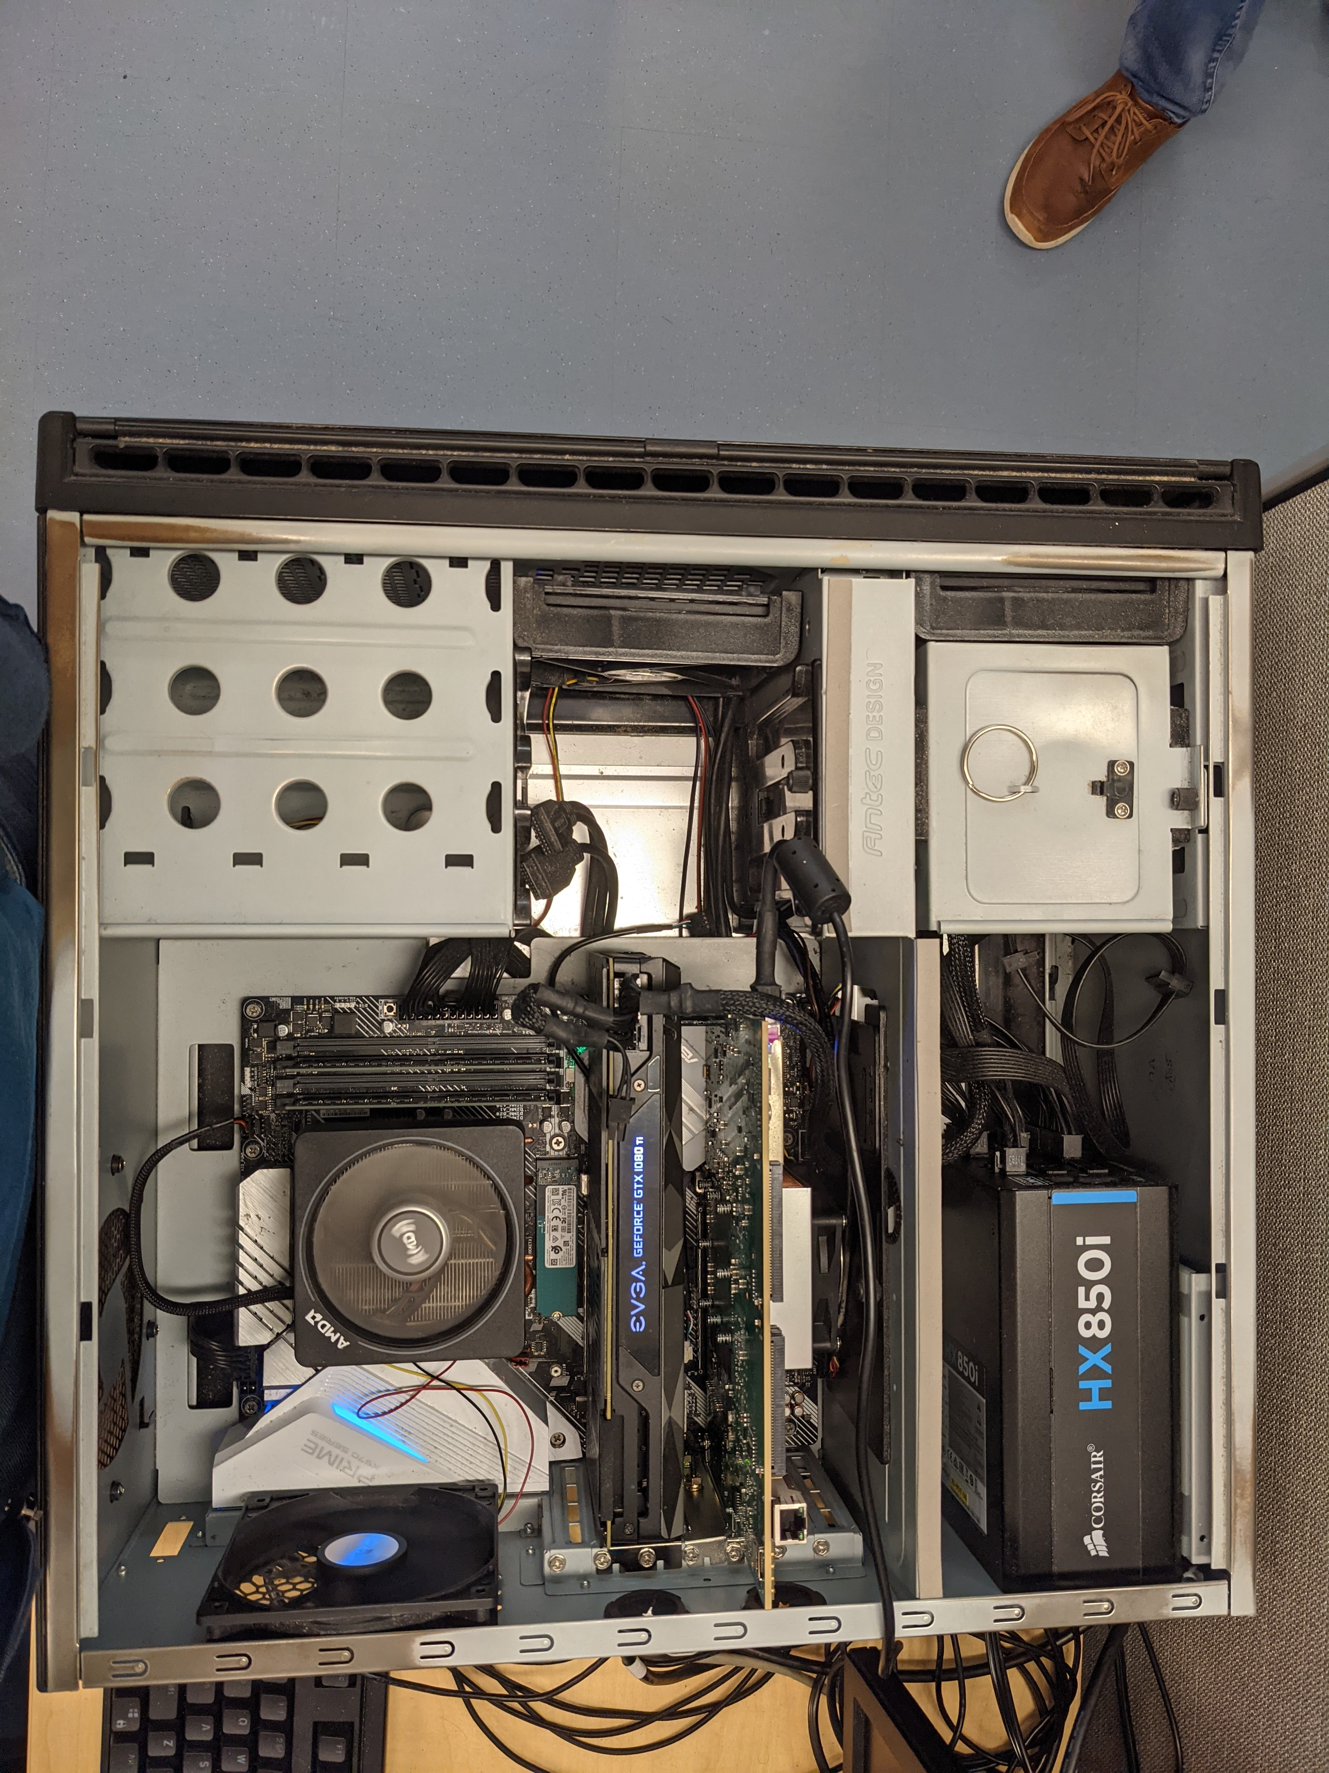
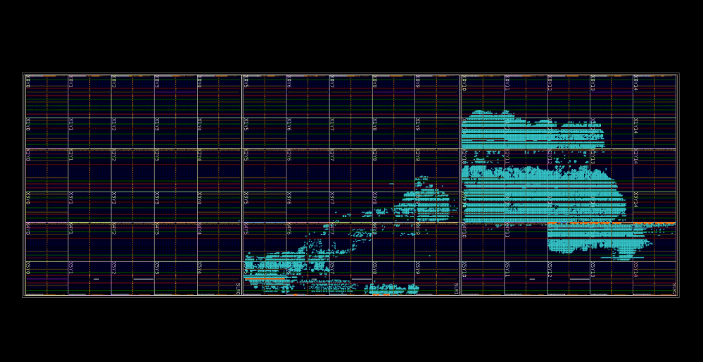
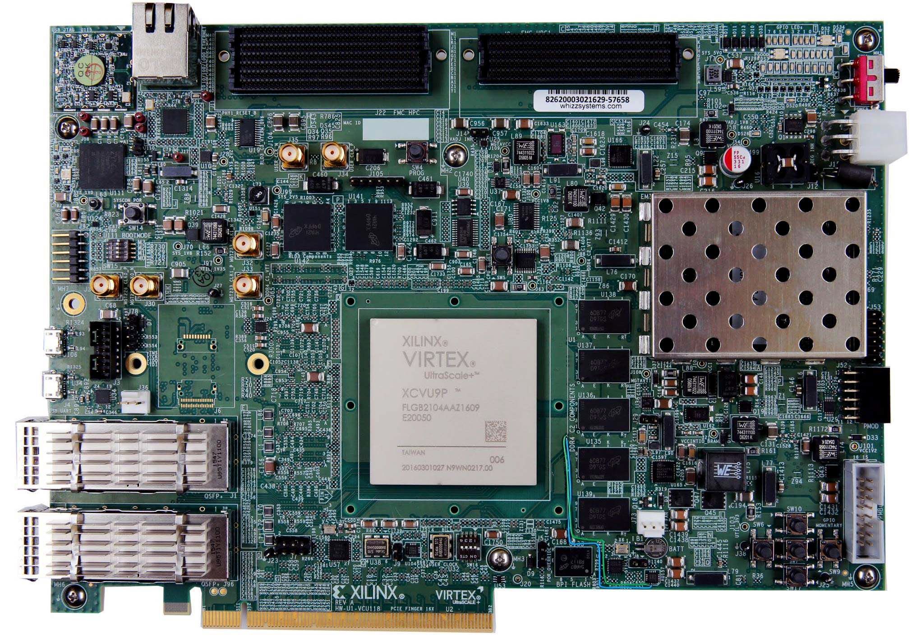
Evaluation
We evaluate the proposed system on a Xilinx Ultrascale+ FPGA
The platform can be extended to other near memory evaluations
Testbed
FPGA Implementation
Notes:
Add sythesiszed figure here
Fist has schematic, second has implementation and reals stuff
Mention MMIO again

Slide 47
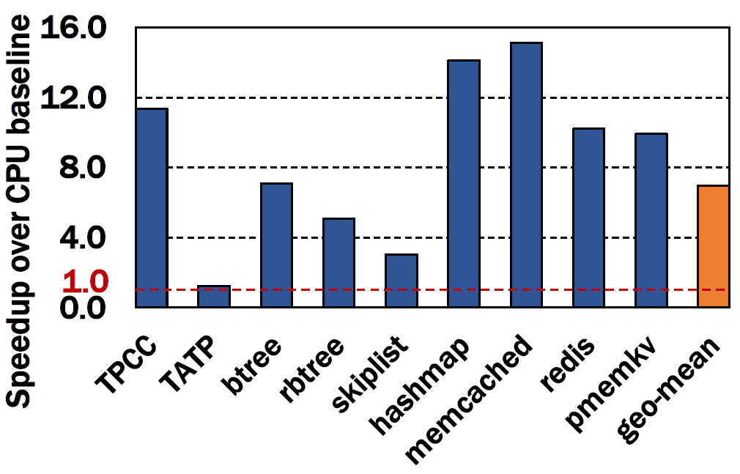
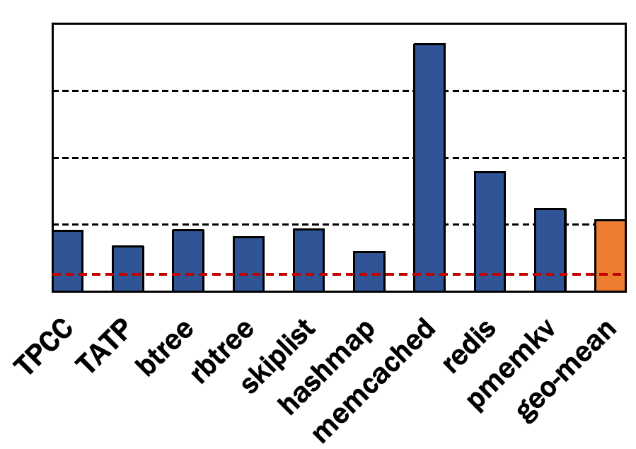
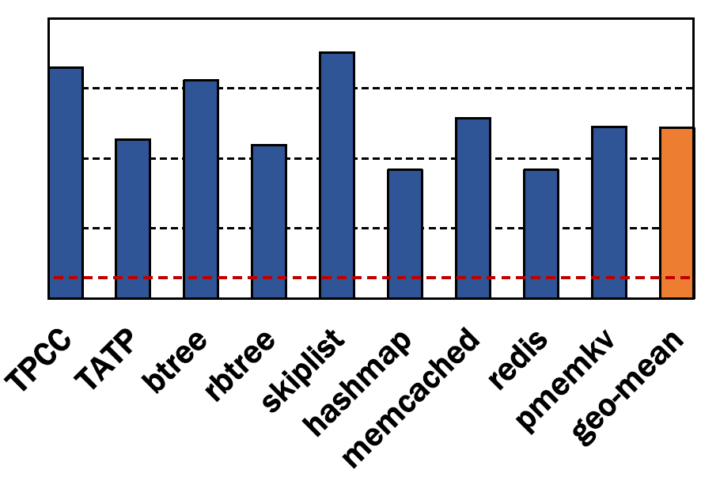
Results: Crash consistency regions
6.9× speedup in logging
4.3× speedup in checkpointing
9.8× speedup in shadow paging
Notes:
Other speedup numbers if time remain multithreading number of devices

Slide 48
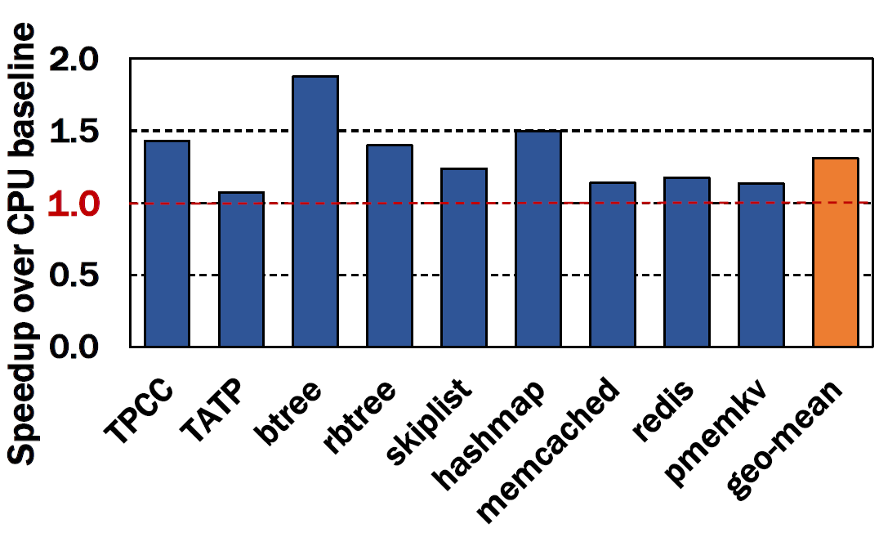
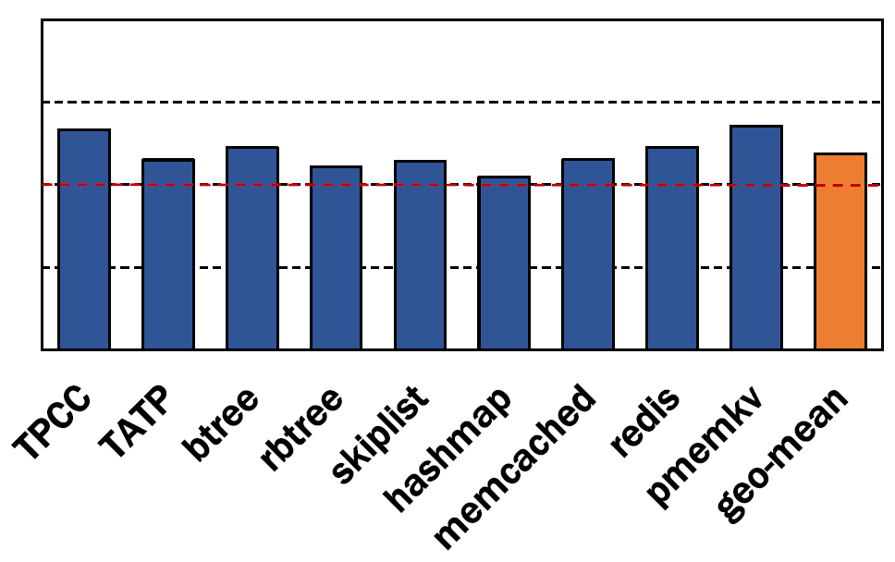
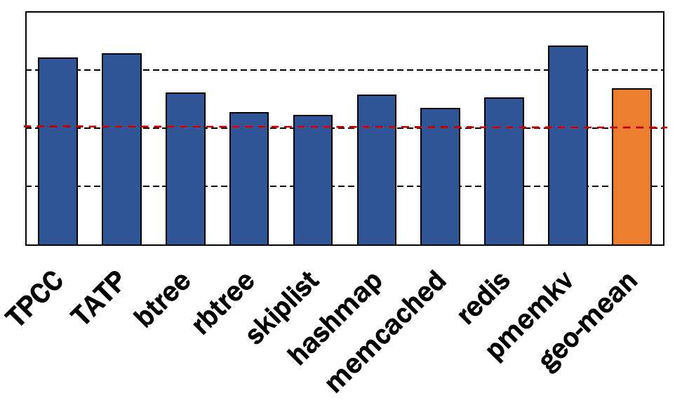
Results: Whole program
1.21× speedup in logging
1.22× speedup in checkpointing
1.33× speedup in shadow paging

Slide 49
Summary
Problem
Crash consistent overhead affects program performance significantly
Key Idea
We execute the data centric operations in crash consistency near memory
We handle ordering near memory to parallelize execution and minimize communication overhead to achieve better performance
Synchronization between devices is used to ensure crash consistency guarantees between devices
Results with real system Implementation
4.3x - 9.8x speedup for consistency mechanisms
1.22x - 1.35x speedup for end-to-end performance
Artifact available at: https://github.com/Systems-ShiftLab/NearPMHW https://github.com/Systems-ShiftLab/NearPMSW

Slide 50
NearPM: A Near-memory Processing System for Storage-class Applications
Yasas Seneviratne, Korakit Seemakhupt, Sihang Liu, and Samira Khan
https://github.com/Systems-ShiftLab/NearPMHW https://github.com/Systems-ShiftLab/NearPMSW
Notes:
Hello everyone I’m Yasas Seneviratne, today I will be presenting our work NearPM: A Near-memory Processing System for Storage-class Applications which I did with my collaborators at the University of Virginia

Slide 51
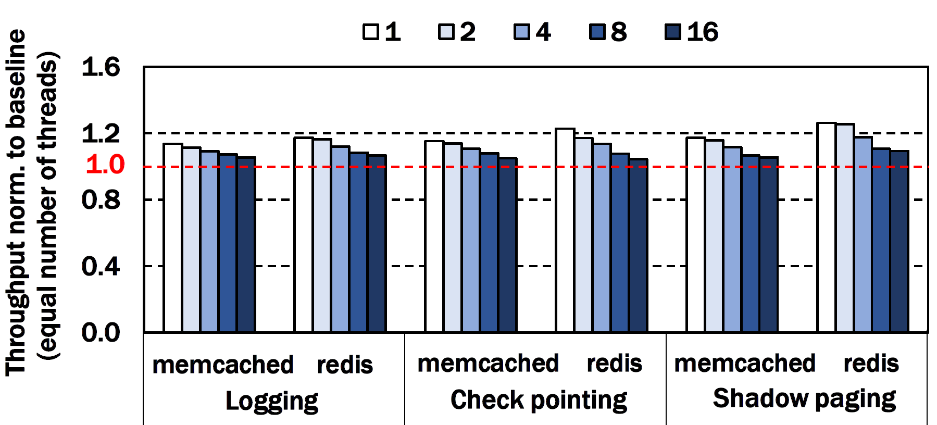
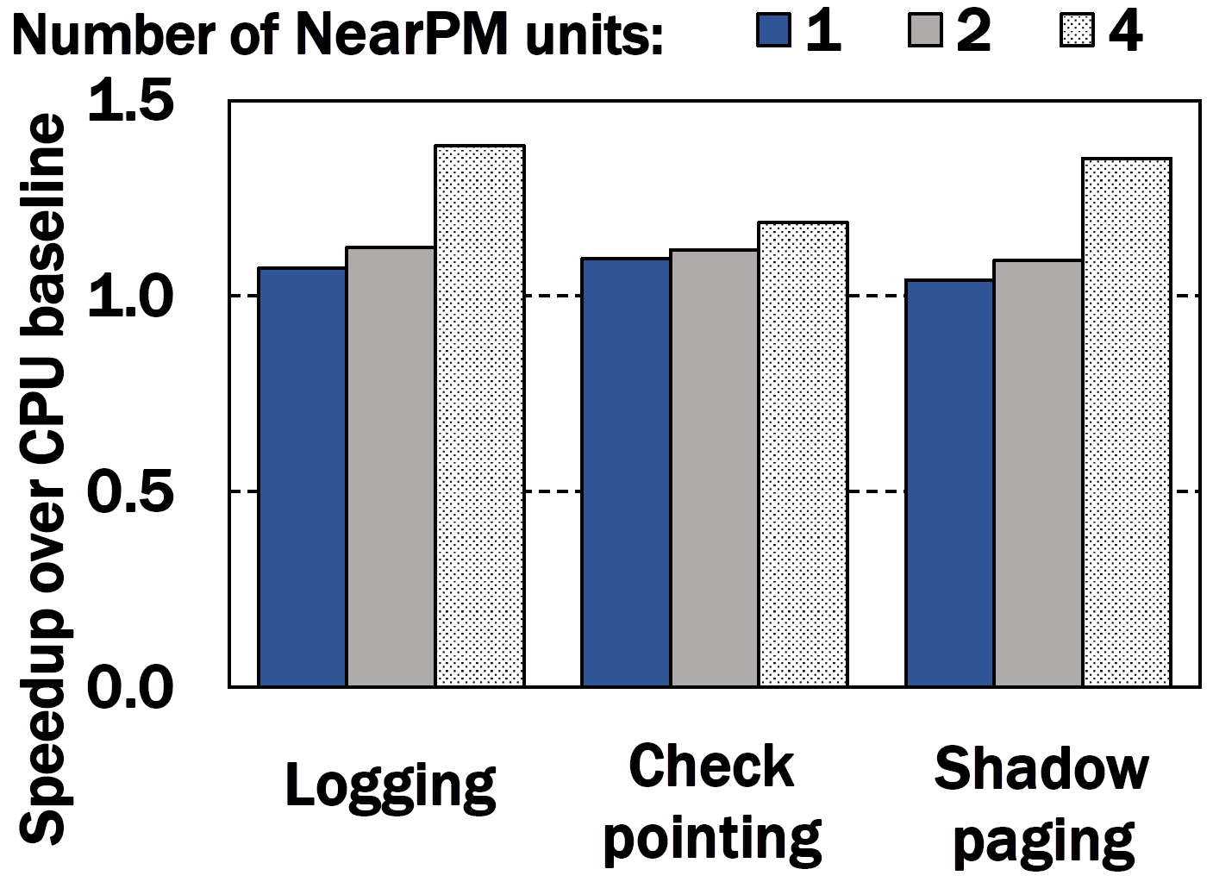
Results
Scalability
Number of threads:

Slide 52
NearPM unit ordering handling
Memory mapped
command queue
1. Check for dependencies before command dispatch
CMD Read
0xC4-0xD4
2. If there are dependencies delay dispatching
NearPM units
NDPU 0
NDPU 1
NearPM access table
NearPM unit ID | Read range | Write range
0 | 0xA0 - 0xB0 | 0xC0 – 0xD0
… | … | …
Buffer enable logic
NDPU 2
PM
0xC0 – 0xD0
NDPU 3
To/From
CPU
Read write queue

Slide 53
NearPM unit ordering handling
Memory mapped
command queue
3. Execute after dependent CMD complete
NearPM units
NDPU 0
NDPU 1
NearPM access table
NearPM unit ID | Read range | Write range
… | … | …
1 | 0xC4 – 0xD4 | 0xE0 -0xF0
Buffer enable logic
CMD dispatcher
NDPU 2
PM
Address monitor and
buffer logic
NDPU 3
To/From
CPU
NearPM handles ordering between NearPM units
Read write queue

